Slide 1
Department of CSE
Probability statistics and queuing theory
22MT2005
Topic:
NORMAL DISTRIBUTION
Session - 9

Slide 2













AIM OF THE SESSION
To familiarize students with Normal distribution and its applications
INSTRUCTIONAL OBJECTIVES
This Session is designed to:
Define Normal distribution
Demonstrate the properties of Normal distribution
Describe characteristics of Normal distribution
Solving problems of Normal distribution with its applications
LEARNING OUTCOMES
At the end of this session, you should be able to:
Define Normal distribution
Describe the properties and Characteristics of Normal distribution
Summarize the concept with their applications

Slide 3

NORMAL DISTRIBUTION
The most important continuous probability distribution in the entire field of statistics is the Normal
distribution.
It is graph, called the normal curve, is the bell shaped curve, which describes approximately many phenomena that occur in nature, industry, and research.
Physical measurements in areas such as meteorological experiments, rainfall studies, and measurements of manufactured parts are often more than adequately explained with a normal distribution.

Slide 4
NORMAL DISTRIBUTION
The Normal Distribution (N.D.) was first discovered by De-Moivre as the limiting form of the binomial model in 1733. The normal distribution is often referred to as the Gaussian distribution, in honour of Karl Friedrich Gauss (1777-1855), who also derived its equation from a study of errors in repeated measurements of the same quantity.

Slide 5

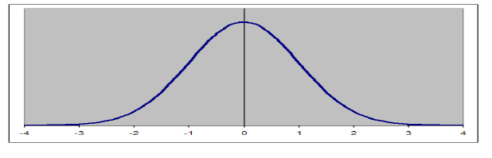
Normal distribution
The basic from of normal distribution is that of a bell, it has single mode and is symmetric about its central values. The
flexibility of using normal distribution is due to the fact that the curve may be centered over any number on the real line and it may be flat or peaked to correspond to the amount of dispersion in the values of random variable.

Slide 6
Normal distribution
Definition
A random variable X is said to follow a Normal Distribution with parameter mean (µ) and variance (𝜎²) if its density
function is given by the probability law
f x = n x u σ = e
1
−
x−µ
σ
2
,
−∞ < x < ∞
σ 2π
Symbolically we can represent the distribution of normal variate as X ~ N(μ, σ²)

Slide 7

Standard Normal distribution
Standard normal distribution:
The distribution of a random variable with mean ‘0’ and variance ‘1’ is called a standard normal distribution. If Z is a standard normal variate then Z~N(0,1).
The probability density function of the standard normal variate Z is given by the probability law
1
_{− 𝑧}2
𝑓 𝑧 =
2
𝑒 , −∞ < 𝑧 < +∞
2𝜋
The standard normal distribution, N (0, 1), is very important because probabilities of any normal distribution
can be calculated from the probabilities of the standard normal distribution.

Slide 8
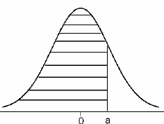
Standard Normal distribution
Note:
1. If X is a normal random variable with mean μ and standard deviation σ, then
_{Z =} X − μ
σ
is a standard normal random variable and hence
P(x₁ < X< x₂ ) = P(
x − μ
< Z <
x − μ
)
1
2
σ σ
2. Suppose Z ~ N(0, 1) is standard normal variate then by using the standard normal distribution area tables, we can calculate
the various probabilities as explained below:
i) P(Z<a)≅P(Z≤a). This probability can be read from the table and is described in the following figure

Slide 9
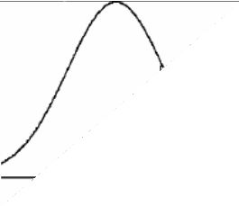
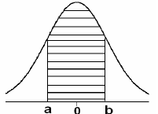
Standard Normal distribution
ii) P(Z>b). This probability can be represented by using the following graph of standard normal distribution and it cannot be read directly from the standard normal tables
iii) P(a≤Z≤b) . This probability can be represented by using the following graph of normal distribution
∴ P(a≤Z≤b) = P(Z≤b) – P(Z≤a), where P(Z≤b) and P(Z≤a) are available directly from standard normal tables.

Slide 10

IMPORTANT FACTS RELATED TO THE SESSION
The Properties of normal probability curve
The mode which is point on the horizontal axis where the curve is a maximum, occurs at x=µ. Hence the mean, median and mode of normal distribution are equal.
The curve is symmetric about a vertical axis through the mean µ.
The curve has its points of inflexion at x=µ±𝜎, it concave downward if µ−𝜎<X< µ+𝜎, and is concave upward otherwise.
The curve approaches the horizontal axis asymptotically as we proceed in either direction away from the mean.
The total area under the curve and above the horizontal axis =1.

Slide 11
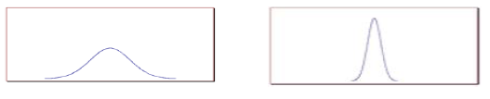
IMPORTANT FACTS RELATED TO THE SESSION
6. The graph of the normal distribution depends on two factors – the mean and the standard deviation. The mean
of the distribution determines the location of the center of the graph, and the standard deviation determines the height and width of the graph. When the standard deviation is large, the curve is short and wide; when the standard deviation is small, the curve is tall and narrow. All normal distributions look like a symmetric, bell- shaped curve, as shown below.
The curve on the left is shorter and wider than the curve on the right, because the curve on the left has a bigger standard deviation.

Slide 12
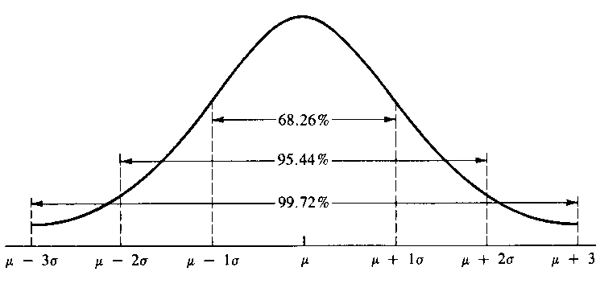
IMPORTANT FACTS RELATED TO THE SESSION
The total area under the normal curve ( ^{+∞} 𝑓 𝑥 𝑑𝑥 = 1) is distributed as follows
׬−∞
covers 68.26% of the area
𝜇 − 𝜎
𝜇 − 2𝜎
𝜇 − 3𝜎
< 𝑥 <
< 𝑥 <
< 𝑥 <
𝜇 + 𝜎
𝜇 + 2𝜎
𝜇 + 3𝜎
covers 95.44% of the area
covers 99.74% of the area, and it can be represented as follows

Slide 13

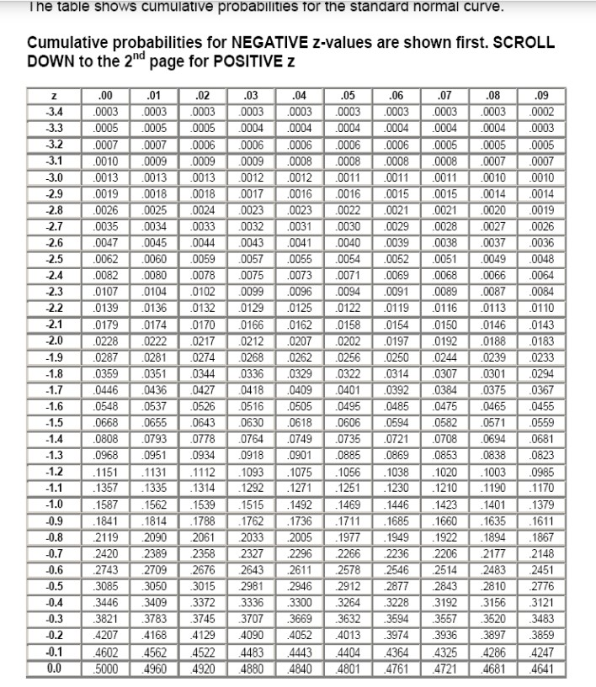
Z Table

Slide 14

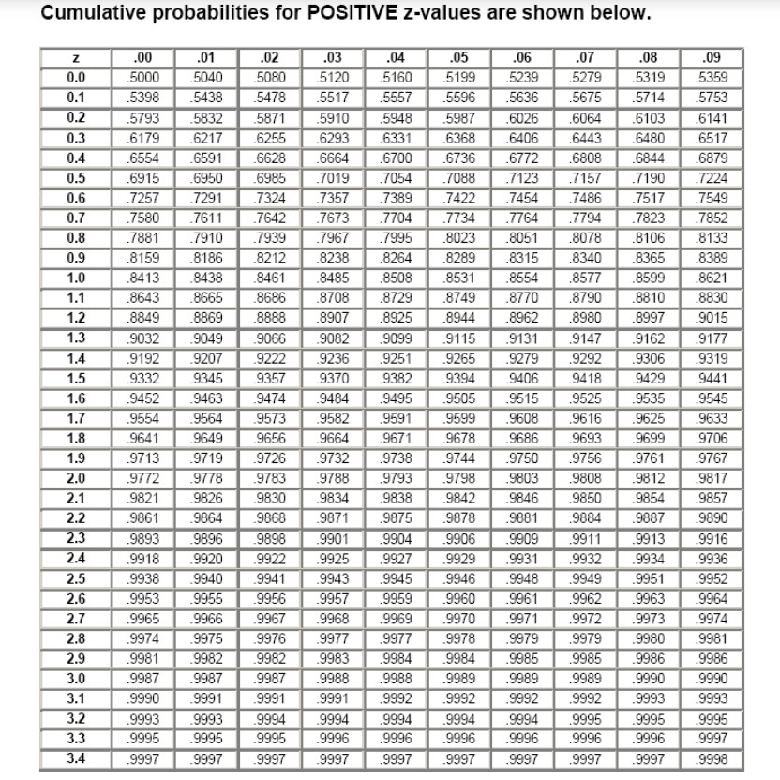
Z table

Slide 15


EXAMPLE 1
1. With an eye toward improving performance, industrial engineers studied the ability of scanners to read the bar codes of various food and household products. The maximum reduction in power, just before the scanner cannot read the bar code at a fixed dictionary is called the maximum attenuation. This quantity, measured in decibles, varies from product to product: After collecting the data, the engineers decided to model the variation in maximum attenuation as a normal distribution with mean 10.1 dB and standard deviation 2.7 dB.
For the next food product, what is the probability that its maximum attenuation is between 8.5 dB and 13.0 dB?
According to the normal model, what proportion of the products has maximum attenuation between 8.5 dB
and 13.0 dB?
What proportion of the products has maximum attenuation greater than 15.1 dB?
Solution: Let X be the maximum attenuation of the next product, Then X is a normal variable with μ=10.1 and σ=2.7.

Slide 16
EXAMPLE 1
X − 10.1
z =
2.7
Probability that the maximum attenuation of the next product is between 8.5 dB and 13.0 dB.
=P(8.5≤X≤13.0)=P(^{8.5−10.1} ≤ X ≤ ^{13.0−10.1})=P(-0.59≤Z≤1.07)=P(Z≤1.07)-P(Z≤-0.59) 2.7 2.7
=0.8577-0.2776=0.5801.
0.5801 is the proportion of the product having maximum attenuation between 8.5 and 13.0 dB
Proportion of the products having maximum attenuation greater than 15.1 dB
=P(X>15.1)=P(Z>(15.1-10.1)/(2.7))=P(Z>1.85)=1-0.9678=0.0322

Slide 17

EXAMPLE 2
The actual amount of instant coffee that a filling machine puts into “4-ounce” jars may be looked upon as a random variable having a normal distribution with σ=0.04 Ounce. If only 2% of the jars are to contain less than 4 ounce, what should be the mean fill of these jars?
Solution: Let X be the amount in ounces of instant coffee that is put into jars. Then the distribution of X is normal with mean μ and standard deviation 0.04 ounce.
We are given that P(X<μ)=0.02
Then P(^{X−μ}<^{4−μ}) = 0.02
0.04 0.04
P(Z<^{4−μ}) = 0.02 ⇨ ^{4−μ} = −2.05 ⇨μ=4.082 ounce.
0.04 0.04

Slide 18


SUMMARY
In this session, the concepts of Normal distribution and its have described
Define Normal distribution and its properties
Applications of Normal distribution

Slide 19







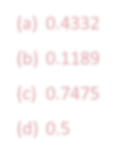
SELF-ASSESSMENT QUESTIONS
1. If X~N(μ,σ²), the points of inflexion of normal distribution curve are:
±μ
μ±σ
σ+μ
±σ
2. If X is a normal variate with mean 20 and variance 64, the probability that X lies between 12 and 32 is
(a) 0.4332
(b) 0.1189
(c) 0.7475
(d) 0.5

Slide 20

TERMINAL QUESTIONS
1. Describe the importance of Normal distribution
2. List out properties of Normal distribution
3. Given a Standard Normal distribution, find the area under the curve which lies
To the left of z=1.43;
to the right of z=-0.89
between z=-2.16 and z=-0.65
to the left of z=-1.39
to the right of z=1.96

Slide 21
TERMINAL QUESTIONS
4. Given a standard normal distribution find the value of k such that
a)𝑃 𝑧 < 𝑘 = 0.0427;
b)𝑃 𝑧 > 𝑘 = 0.2946;
c) P(-0.93<Z<k)=0.7235.
5. In a test on 2000 electric bulbs it was found that the life of a particular make was normally distributed with an average life of 2040 hours and S.D. of 60 hours. Estimate the number of bulbs likely to burn for
(a) more than 2150 hours (b) less than 1950 hours
more than 1920 hours and but less than 2160 hours.
exactly 1960 hours.

Slide 22

TERMINAL QUESTIONS
6. In an industrial process the diameter of a ball bearing is an important component part. The buyer sets specifications on the diameter to be 3.0±0.01 cm. The implication is that no part falling outside these specifications will be accepted. It is known that in the process the diameter of a ball bearing has a normal distribution with mean μ=3.0 and standard deviation σ
=0.005. On the average, what % of manufactured ball bearings will be scraped?

Slide 23

REFERENCES FOR FURTHER LEARNING OF THE SESSION
Reference Books:
Chapter 1 of TP1: William Feller, An Introduction to Probability Theory and Its Applications: Volume 1, Third Edition, 1968 by John Wiley & Sons,Inc.
Richard A Johnson, Miller& Freund’s Probability and statistics for Engineers, PHI, New Delhi, 11th Edition (2011).
Sites and Web links:
Continuous Random Variables and their Distributions (probabilitycourse.com)
Notes: sections 1 to 1.3 of http://www.statslab.cam.ac.uk/~rrw1/prob/prob-weber.pdf
3. Section 3.1.1 of TS1: Alex Tsun, Probability & Statistics with Applications to Computing (Available at:
http://www.alextsun.com/files/Prob_Stat_for_CS_Book.pdf)
Video: https://www.youtube.com/watch?v=- 5sOBWV0qH8&list=PLeB45KifGiuHesi4PALNZSYZFhViVGQJK&index=19

Slide 24

THANK YOU
Team – PSQT EVEN SEM 2023-24

